Slide 1
The Convenience Factor: Residential Valuation Using Machine Learning
A Haystacks.ai Project

Slide 2
Introduction
Haystacks.ai has conducted extensive analysis on internal amenities (in-complex daycare, gyms) and their effect on rental prices.
Now, we want to find out how external amenities, such as grocery stores and schools, directly influence rental price.
These external amenities will be referred to as “Points of Interests” or POIs

Slide 3
How do external amenities impact rental prices on Build-to-Rent and Single/Multi Family Rental Homes?
Which external amenities significantly influence rental price the most?
To what extent does distance affect rental prices in regards to selected external amenities?
The Business Questions

Slide 4
Convenience (As a Feature)
Grocery stores are divided into traditional and non-traditional types, are dependent on their regions, and are occasionally divided between their size, price of goods, or even year-end sales.
Supermarket | A large shop for groceries. It's a full service grocery store that often sells a variety of non-food products as well. Almost always part of a chain (Publix, Harris Teeter, Piggly Wiggly, BiLo, Ingles, Bells, Earthfare).
Variety Store | A variety store or price-point retailer is a retail shop that sells inexpensive items, usually with a single price point for all items in the store (Dollar Tree, Family Dollar, Dollar General).
Warehouse Club | A non-traditional membership-retailer hybrid that sells bulk products in a warehouse environment. At least 40% of products devoted to grocery (Costco, Sam’s Club, BJ’s).
Supercenter | A non-traditional food and drug store combination that sells mass merchandise. At least 40% of products devoted to grocery (Target, Walmart).
Convenience Store | A non-traditional, limited store that sells variety of general merchandise, including packaged food products (7-Eleven, Quick Trip.)

Slide 5
What Does the Literature Say?
Distance is Statistically Significant
Type of Store Matters
It was consistently shown that, the closer a home was to selected amenities, there was an increase in rental prices. This both applied to higher income households and low income households.
Higher income households are able to change grocery stores more easily, are more able to travel, and are more interested in service availability (EG parking).
Development Trends Spark Rental Price Increase
Considered “revitalization”, even in poor neighborhoods, the development of new grocery stores shows a positive increase in rental prices. This applies most to those houses closest to the new lots.

Slide 6
Features as a Measurement
Because of the variety and quality of features, we will vary whether we use distance, density, or both based on the type of feature being used.
Distance-Based
Density-Based
Using sources like Google.api, Foursquare, and OpenStreetMap, we will join geospatial dataset with the rental dataset to find most influential feature influences. As a base, it would be closest *feature* to location given.
However, we also have a previous data that gave us set limits of: 0-199.9, 200-399.9, 400-599.9, and 500-800 meters. 400-599.9 was considered not statistically significant. This should be kept in mind.
Essentially the same as the distance-based, except using quantity within a 1 mile radius. We will keep ideally keep the same radius throughout of 1 mile throughout the analysis to ensure features are measured on comparable scales. See previous comments on distance about significance.

Slide 7
OUR GUIDING PRINCIPLES
Random Forest
XGBoost
1.
2.
Capture non-linear relationships and interactions between amenities and rental prices.
Like Random Forest, but typically more powerful and faster, especially with large datasets. It also handles missing values and scales well.
Multiple Linear Regression
Kernel Ridge Regression
3.
4.
Seek to understand the linear relationship between rental price and external amenities along with other features.
Useful for capturing complex non-linear effects without requiring explicit interaction terms or feature engineering.

Slide 8
ROADMAP
WEEK | OBJECTIVE
ONE: Design and Data Gathering | Finalize project proposal based on Week Zero’s discussions; begin data collection.
TWO: Extract, Transform, and Load | Finalize a geospatial data set that can be merged for machine learning; begin creating models.
THREE: Modeling | Begin Modeling, present initial findings or ”Minimum Viable Product”
FOUR: Refine | Refine MVP based on feedback and draft summary paper
FIVE: Finalize Findings | Summarize findings in Capstone paper
SIX: *Buffer* | Unknown if needed for more time with modeling and/or Capstone paper

Slide 9
Table 1: Score Comparison for Distance, Train-Val
Model | R-Squared | Mean Squared Error | Root Mean Squared Error | Mean Absolute Percentage Error
XGBoost | 0.6408 (0.5676) | 296165.2733 (360701.0136) | 544.2107 (600.5839) | 0.1435 (0.1536)
Random Forest | 0.6006 (0.4967) | 329276.6278 (419874.5748) | 573.8263 (647.9773) | 0.1558 (0.1641)
Table 2: Score Comparison for Distance, Test
Model | R-Squared | Mean Squared Error | Root Mean Squared Error | Mean Absolute Percentage Error
XGBoost | 0.5577 | 377794.2855 | 614.6497 | 0.1554
Random Forest | 0.5082 | 420034.1152 | 648.1004 | 0.1689
Notes:
Mean squared error (MSE) measures error in statistical models by using the average squared difference between observed and predicted values. Smaller value represents better predictive accuracy. MAPE of 0% represents perfect accuracy. ***Bolded means it’s the superior version compared between the validation and test, bolded model means it’s best model in the set.
Summary: When it came to distance, XG Boost was overwhelmingly the superior model for both the train-val set (80%) and the Test set (20%). The Train-Val set was also superior for the Random Forest model.
Make results not influenced by grocery store features (benchmark model). Documentation for methods (flowchart). A record of absolute clarity of what is being done. Do geospatial features matter for machine learning? Target audience is geospatial analysts, real estate analysts/data scientists. Is this better than a standard model?

Slide 10
Table 3: Score Comparison for Distance, Train-Val (MLR, Log)
Model | R-Squared | Mean Squared Error | Root Mean Squared Error | Mean Absolute Percentage Error
MLR | 0.3815 (0.3802) | 0.0674 (0.0676) | 0.2597 (0.2599) | 2.3025 (2.2794)
Ridge | 0.3815 (0.3803) | 0.0674 (0.0676) | 0.2597 (0.2599) | 0.0230 (0.0228)
Lasso | 0 | 0.1090 | 0.3302 | 0.0309 (0.0310)
Table 4: Score Comparison for Distance, Test (MLR, Log)
Model | R-Squared | Mean Squared Error | Root Mean Squared Error | Mean Absolute Percentage Error
MLR | 0.2963 | 0.0794 | 0.2819 | 2.3501
Ridge | 0.2969 | 0.0794 | 0.2818 | 0.0235
Lasso | -0.0001 | 0.1129 | 0.3360 | 0.0313
Notes:
When it came to MLR, the Train-Val set had a tendency to be somewhat superior, but with only a minor difference between the MLR and the Ridge regression. Ridge was chosen as superior because of the difference in MAPE. Ridge, as a model, is more clearly seen is superior in the Test set.

Slide 11
Table 5: Score Comparison for Density One, Train-Val
Model | R-Squared | Mean Squared Error | Root Mean Squared Error | Mean Absolute Percentage Error
XGBoost | 0.5766 (0.4747) | 349099.7736 (438598.0321) | 590.8467 (662.2673) | 0.1566 (0.1641)
Random Forest | 0.5583 (0.4630) | 364216.0566 (448322.1936) | 603.5032 (669.5687) | 0.1628 (0.1690)
Table 6: Score Comparison for Density One, Test
Model | R-Squared | Mean Squared Error | Root Mean Squared Error | Mean Absolute Percentage Error
XGBoost | 0.4833 | 441114.6293 | 664.1646 | 0.1674
Random Forest | 0.4801 | 443811.2740 | 666.1916 | 0.1716
Notes:
Even for density, the pattern is repeated. XGBoost shows to be the superior model for both the test set and the train-val set, and the train-val set has the better scores. This trend continues to be the same for all radiuses.

Slide 12
Table 7: Score Comparison for Density One, Train-Val (MLR, Log)
Model | R-Squared | Mean Squared Error | Root Mean Squared Error | Mean Absolute Percentage Error
MLR | 0.3928 (0.3970) | 0.0662 (0.0659) | 0.2574 (0.2567) | 2.3013 (2.2724)
Ridge (?) | 0.3927 (0.3969) | 0.0663 (0.0659) | 0.2574 (0.2568) | 0.0230 (0.0227)
Lasso | 0 | 0.1091 (0.1093) | 0.3303 (0.0310) | 0.0309 (0.3306)
Table 8: Score Comparison for Density One, Test (MLR, Log)
Model | R-Squared | Mean Squared Error | Root Mean Squared Error | Mean Absolute Percentage Error
MLR | 0.3174 | 0.0768 | 0.2772 | 2.3268
Ridge | 0.3178 | 0.0768 | 0.2771 | 0.0233
Lasso | -0.0001 | 0.1126 | 0.0313 | 0.3355
Notes:
Interestingly, the validation scores themselves were superior for density one mile, not the train-val set, except for the Lasso model. Ridge was only chosen possibly as a superior model based on MAPE. Like with distance, Ridge is more clearly seen as a superior model based on the test set.

Slide 13
Table 9: Score Comparison for Density Three, Train-Val
Model | R-Squared | Mean Squared Error | Root Mean Squared Error | Mean Absolute Percentage Error
XGBoost | 0.6636 (0.6024) | 277395.2322 (331969.7890) | 526.6832 (576.1682) | 0.1410 (0.1480)
Random Forest | 0.6405 (0.5635) | 296433.2675 (364454.9084) | 544.4569 (603.7010) | 0.1493 (0.1554)
Table 10: Score Comparison for Density Three, Test
Model | R-Squared | Mean Squared Error | Root Mean Squared Error | Mean Absolute Percentage Error
XGBoost | 0.5614 | 374371.7018 | 611.8592 | 0.1512
Random Forest | 0.5486 | 385329.8807 | 620.7495 | 0.1586
Notes:
The three mile scores are closer to the distance scores, with the caveat that the test set has the random forest model coming out as superior compared to the XGBoost. Otherwise, the train-val set is still overwhelmingly superior.

Slide 14
Table 11: Score Comparison for Density Three, Train-Val (MLR, Log)
Model | R-Squared | Mean Squared Error | Root Mean Squared Error | Mean Absolute Percentage Error
MLR | 0.4546 (0.4590) | 0.0662 (0.0591) | 0.2574 (0.2432) | 2.1834 (2.1583)
Ridge | 0.4546 (0.4589) | 0.0595 (0.0592) | 0.2439 (0.2432) | 0.0218 (0.0216)
Lasso | 0 | 0.1091 (0.1093) | 0.3303 (0.0310) | 0.0309 (0.3306)
Table 12: Score Comparison for Density Three, Test (MLR, Log)
Model | R-Squared | Mean Squared Error | Root Mean Squared Error | Mean Absolute Percentage Error
MLR | 0.3864 | 0.0691 | 0.2628 | 2.1957
Ridge | 0.3866 | 0.0690 | 0.2628 | 0.0220
Lasso | -0.0001 | 0.1126 | 0.0313 | 0.3355
Notes:
The three mile log-transformed results give similar findings to the one-mile results, with the validation set having the highest scores. Unlike with the one mile, Ridge is more clearly the superior model for both the train-val set and the test set.

Slide 15
Table 13: Score Comparison for Density Five, Train-Val
Model | R-Squared | Mean Squared Error | Root Mean Squared Error | Mean Absolute Percentage Error
XGBoost | 0.6953 (0.6397) | 251218.1861 (300821.4735) | 501.2167 (548.4719) | 0.1332 (0.1394)
Random Forest | 0.6721 (0.6031) | 270348.6326 (331368.1424) | 519.9506 (575.6458) | 0.1421 (0.1480)
Table 14: Score Comparison for Density Five, Test
Model | R-Squared | Mean Squared Error | Root Mean Squared Error | Mean Absolute Percentage Error
XGBoost | 0.5968 | 344173.7049 | 586.6632 | 0.1437
Random Forest | 0.5753 | 362555.8689 | 602.1261 | 0.1506
Notes:
The scores prove to be progressive, where, as the radius increases in value, the scores also increase. Density three is close in value to the distance values, but density five proves to have the highest scores and the best models.

Slide 16
Table 15: Score Comparison for Density Five, Train-Val (MLR, Log)
Model | R-Squared | Mean Squared Error | Root Mean Squared Error | Mean Absolute Percentage Error
MLR | 0.4773 (0.4843) | 0.0662 (0.0564) | 0.2574 (0.2374) | 2.1326 (2.1052)
Ridge | 0.4773 (0.4842) | 0.0570 (0.0564) | 0.2388 (0.2375) | 0.0213 (0.0210)
Lasso | 0 | 0.1091 (0.1093) | 0.0309 (0.0310) | 0.3303 (0.3306)
Table 16: Score Comparison for Density Five, Test (MLR, Log)
Model | R-Squared | Mean Squared Error | Root Mean Squared Error | Mean Absolute Percentage Error
MLR | 0.4057 | 0.0669 | 0.2586 | 2.1410
Ridge | 0.4059 | 0.0669 | 0.2586 | 0.0215
Lasso | -0.0001 | 0.1126 | 0.3355 | 0.0313
Notes:
Continuing the trend, the validation set was superior to all other sets, with the exception of the Lasso. Ridge was the superior model.

Slide 17
Table 18: Score Comparison for Baseline, Train-Val
Model | R-Squared | Mean Squared Error | Root Mean Squared Error | Mean Absolute Percentage Error
XGBoost | 0.5282 (0.4291) | 388951.4360 (476278.6393) | 623.6597 (690.1294) | 0.1613 (0.1699)
Random Forest | 0.5267 (0.4197) | 390247.4735 (484131.0255) | 624.6979 (695.7952) | 0.1641 (0.1718)
Table 19: Score Comparison for Baseline, Test
Model | R-Squared | Mean Squared Error | Root Mean Squared Error | Mean Absolute Percentage Error
XGBoost | 0.4287 | 487939.5256 | 698.5267 | 0.1735
Random Forest | 0.4316 | 485492.8151 | 696.7731 | 0.1755
Notes:
The baseline had the worst scores overall, even being worse than the distance scores. For some reason, the random forest was a superior model in regards to the test set. However, this was tested three times and different results were reported. This can be explained by randomization due to: training data split randomization, as well as randomization in the regressors (simply because of the complex operation even though the state is set).

Slide 18
Table 20: Score Comparison for Baseline, Train-Val (MLR, Log)
Model | R-Squared | Mean Squared Error | Root Mean Squared Error | Mean Absolute Percentage Error
MLR | 0.3526 (0.3535) | 0.0706 (0.0705) | 0.2657 (0.2655) | 2.3651 (2.3408)
Ridge | 0.3526 (0.3535) | 0.0706 (0.0705) | 0.2657 (0.2655) | 0.0236 (0.0234)
Lasso | 0 | 0.1090 (0.1090) | 0.3302 (0.3302) | 0.0309 (0.0310)
Table 21: Score Comparison for Baseline, Test (MLR, Log)
Model | R-Squared | Mean Squared Error | Root Mean Squared Error | Mean Absolute Percentage Error
MLR | 0.2663 | 0.0828 | 0.2878 | 2.4180
Ridge | 0.2670 | 0.0828 | 0.2877 | 0.0242
Lasso | 0 | 0.1129 | 0.3360 | 0.0313
Notes:
The MLR models were also seen as inferior to the normal models.

Slide 19
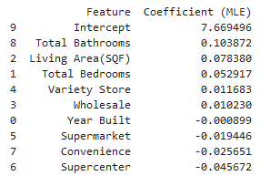
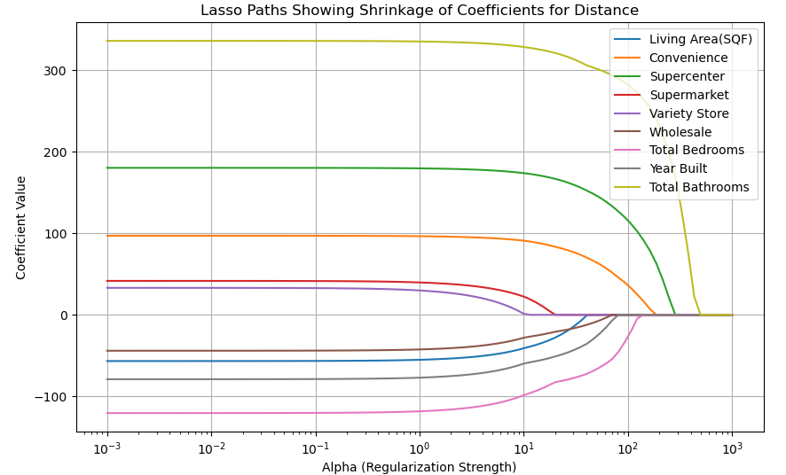
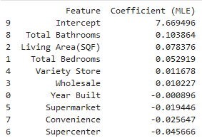
MLR: Distance
MLR
Ridge
Notes:
Lasso regression applies a penalty on the absolute size of coefficients. As alpha increases:
Features with weaker or redundant relationships to the target variable are penalized more quickly, so their coefficients shrink to zero at lower alpha values.
Features with a stronger or more independent predictive relationship withstand the penalty longer, meaning their coefficients remain non-zero even at higher alpha values.
Therefore: If a feature’s coefficient doesn’t shrink to zero until a large alpha value, then the feature has a stronger influence.

Slide 20
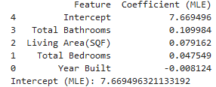
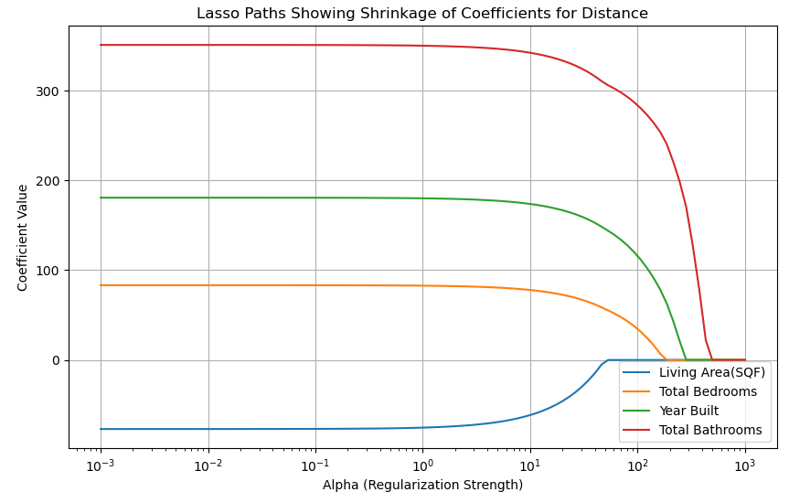
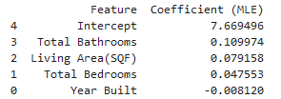
MLR: Baseline
MLR
Ridge
Notes:
Bathrooms still has the strongest influence, as was the same when the independent variables were kept. Year built ironically now has a positive coefficient value instead of a negative one, and same for bedrooms. The MLR is mostly the same.

Slide 21
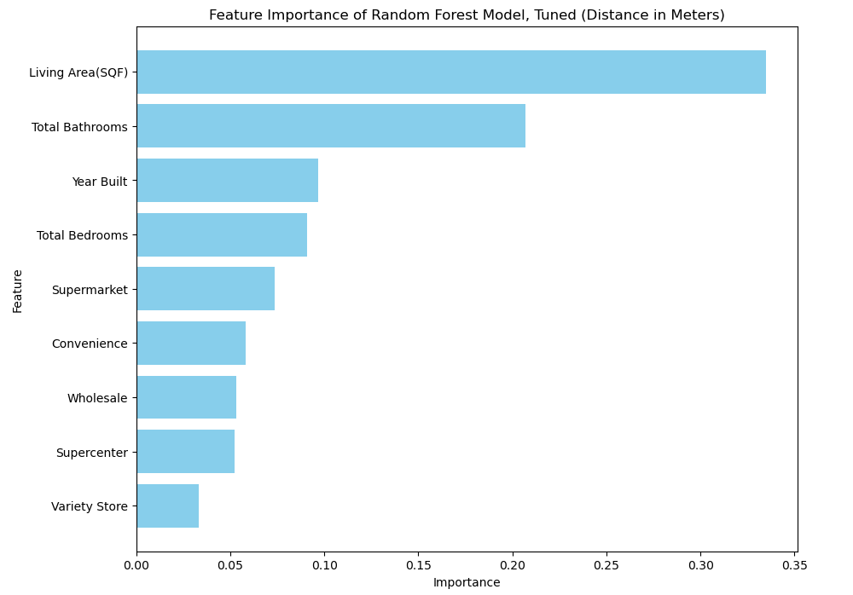
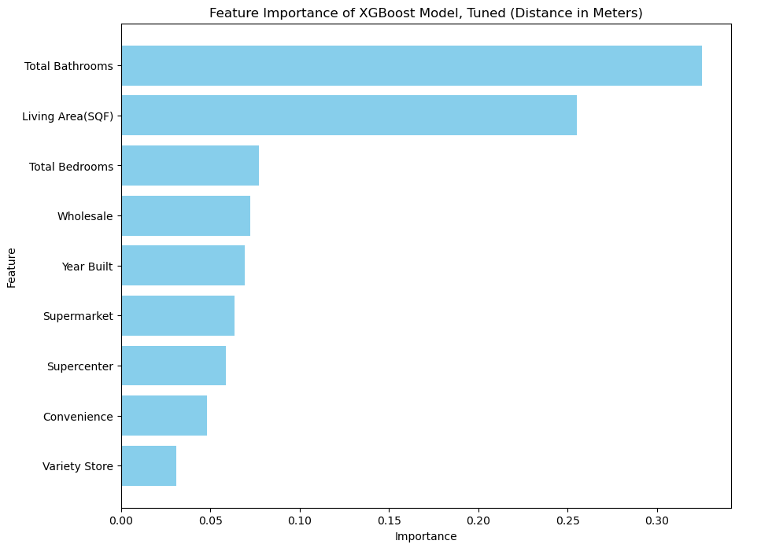
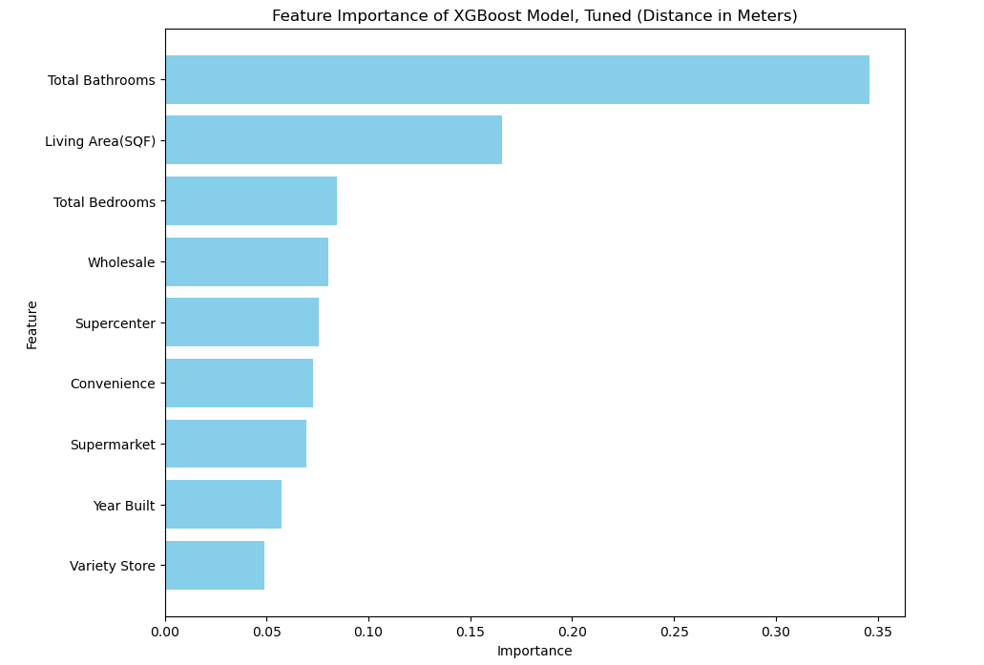
Random Forest: Distance
XGBoost: Distance
Notes:
Perhaps having the greatest disparity in results, the RF model says the greatest importances are Supermarket and Wholesale, while XGBoost says it’s Wholesale and Supermarket. This also goes against the Lasso regression, which claimed Supercenter should be the strongest influencer of the store features.

Slide 22
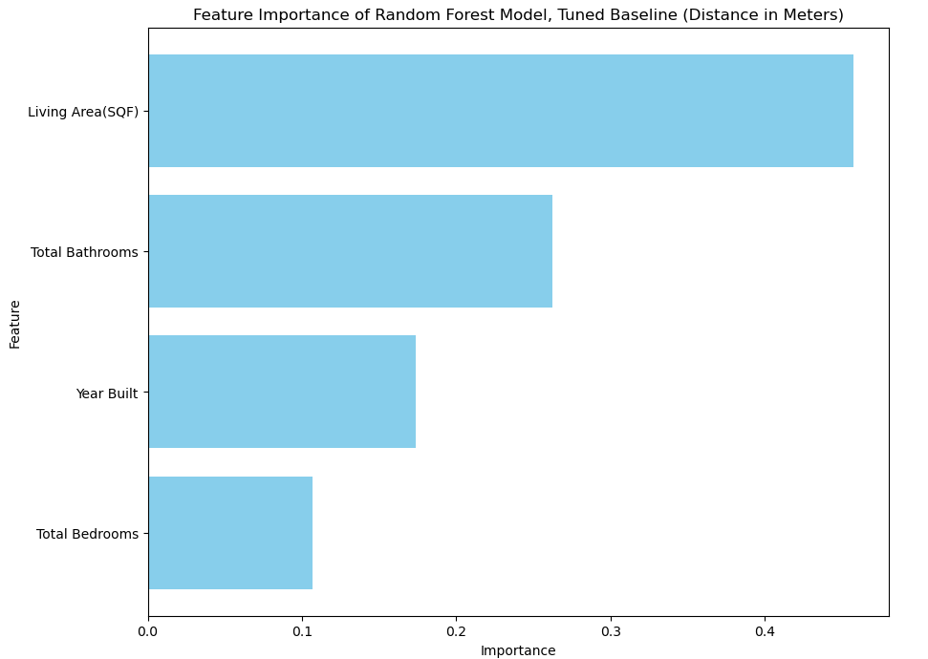
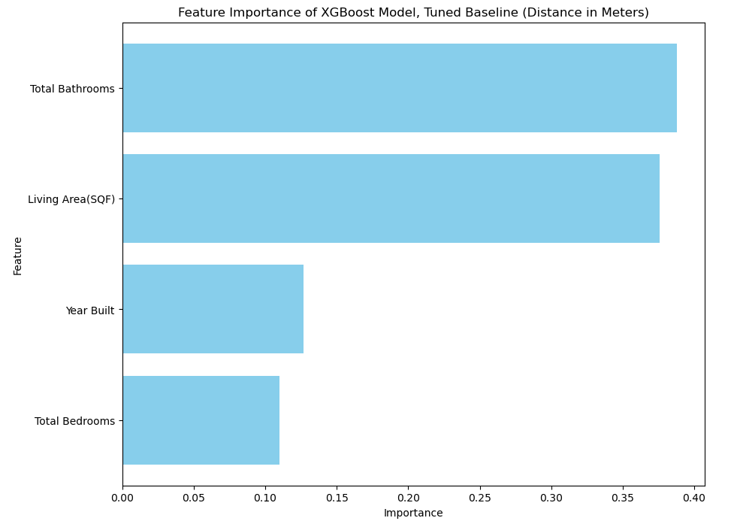
Random Forest: Distance
XGBoost: Distance
Notes:
Perhaps having the most bizarre difference, the XGBoost model does not inflate total bathrooms as much as it did when the IV’s were included. In addition, the importance is much, much higher compared to the other version. The Random forest model is more the same, though.

Slide 23
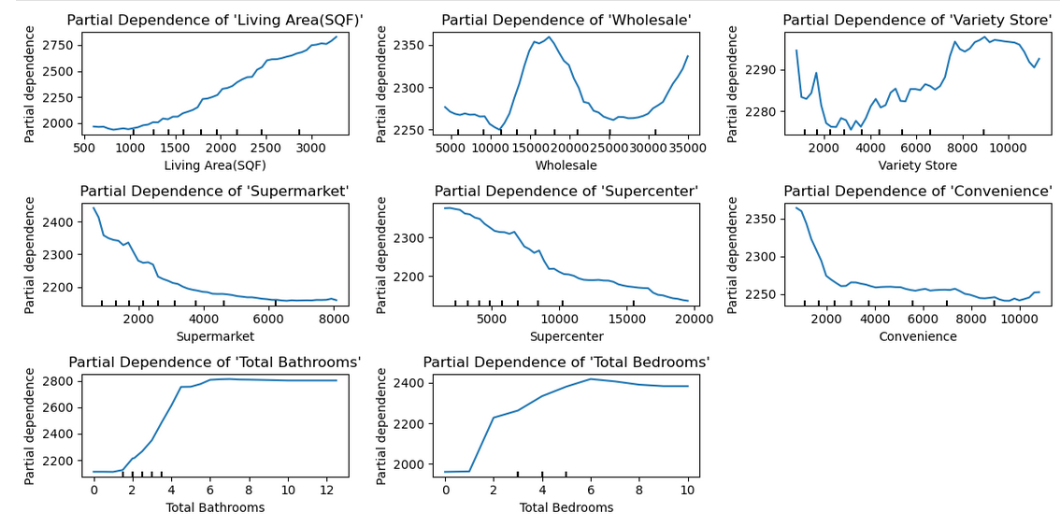
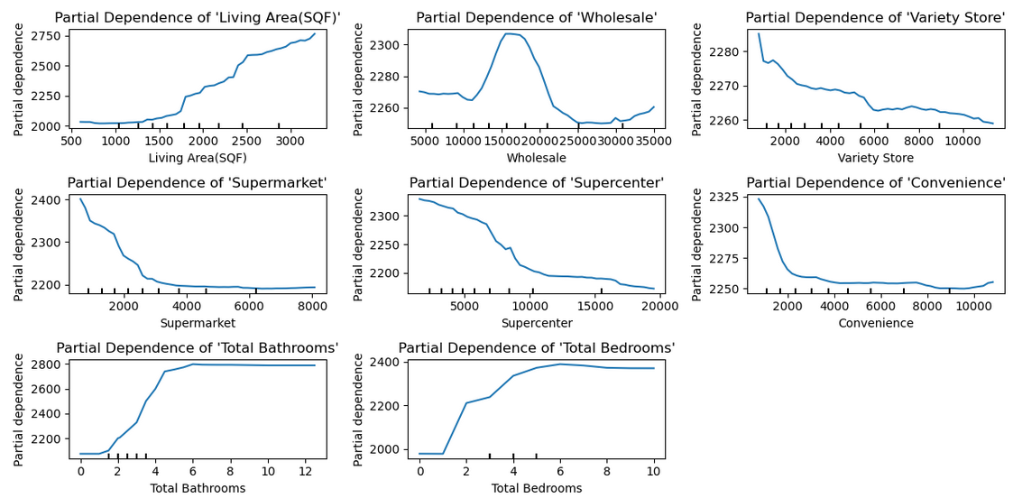
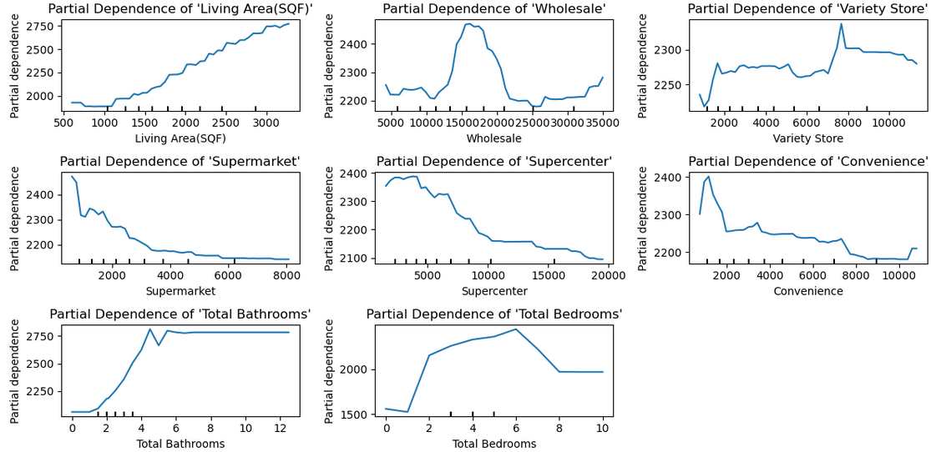
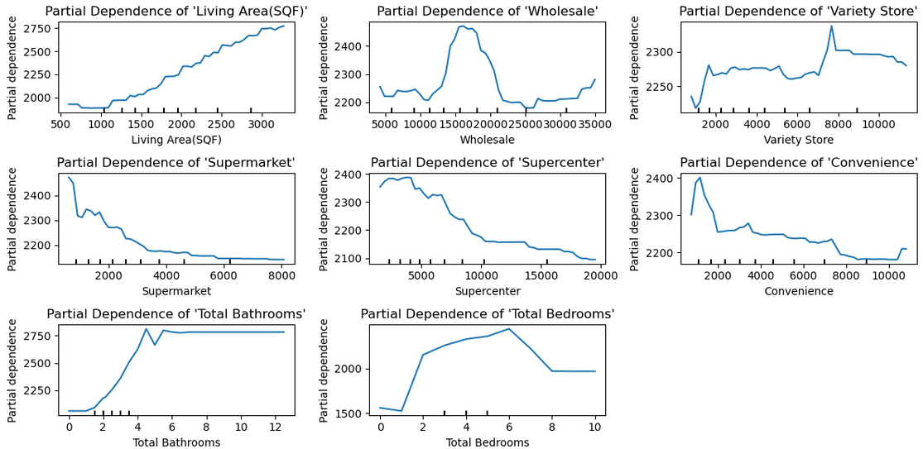
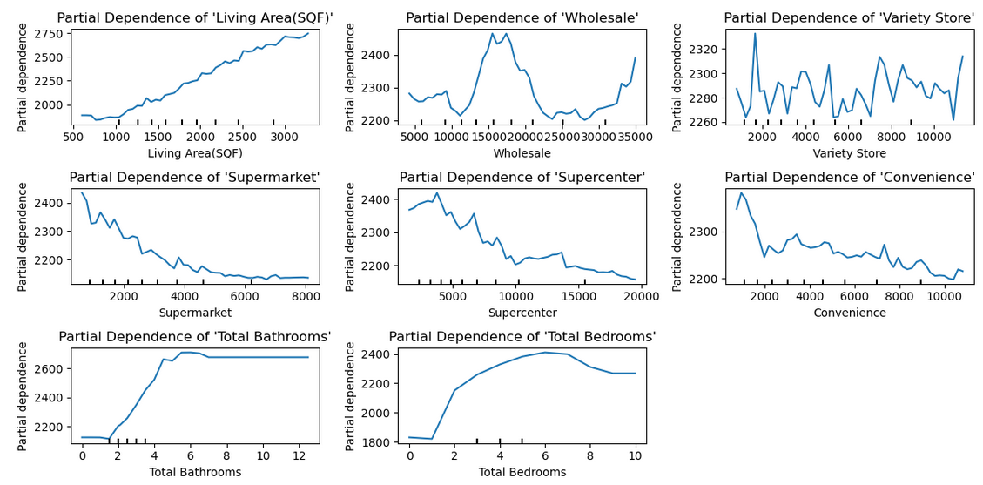
Random Forest: Distance, Partial Dependency Display
XGBoost: Distance, Partial Dependency Display
Notes:
Despite disagreeing on importance, the dependency is mostly the same except when it comes to variety store. It would seem that, with the exception of wholesale, having the store closer is more critically important and then there is a sharp drop in dependency.

Slide 24
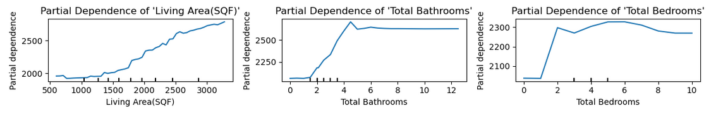
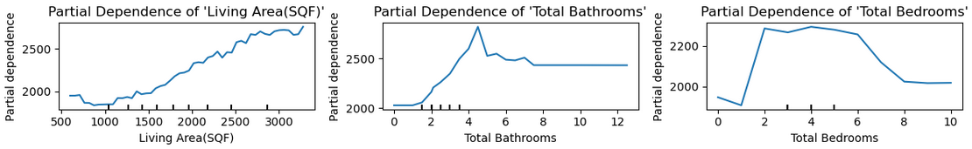
Random Forest: Distance, Partial Dependency Display
XGBoost: Distance, Partial Dependency Display
Notes:
Mostly the same.

Slide 25
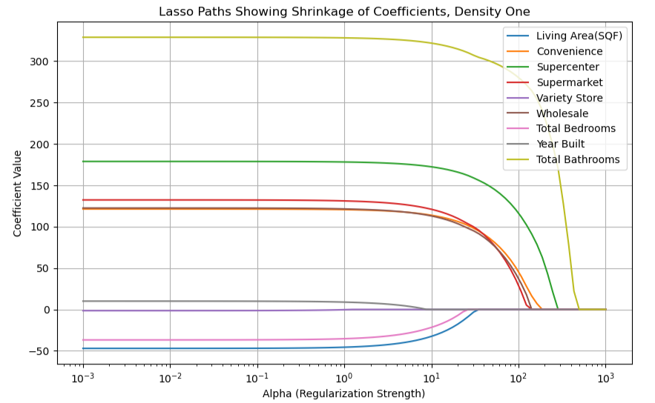
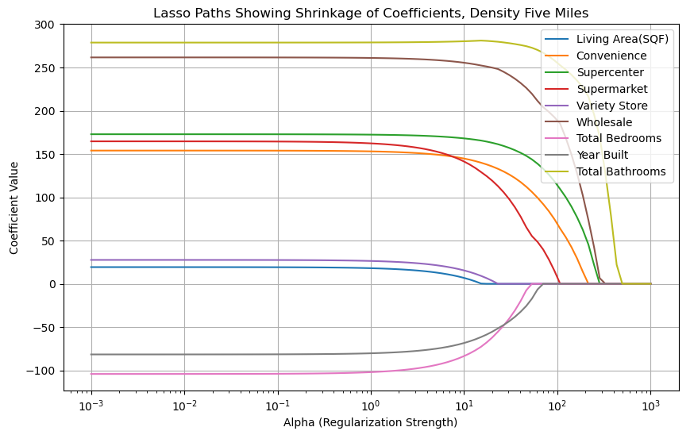
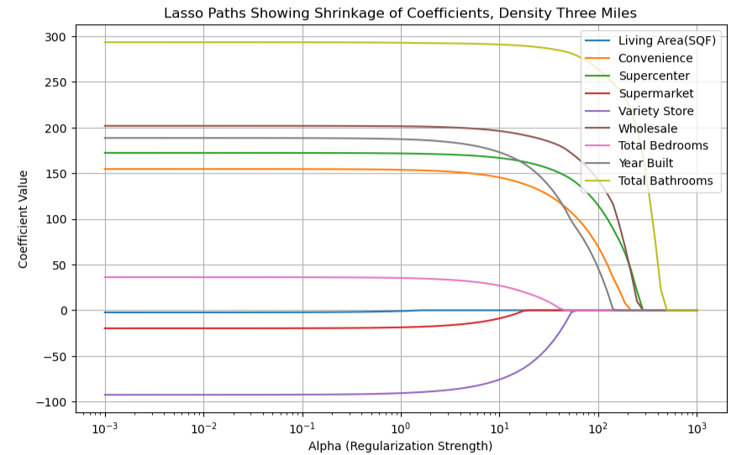
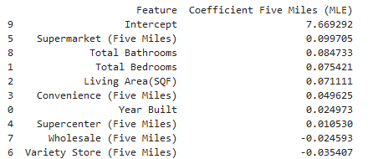
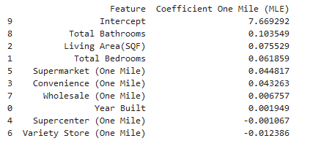
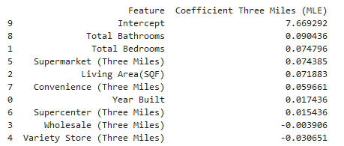
MLR: Density
Notes:
Wholesale and supercenters consistently show as withstanding the penalty longer, therefore having a stronger influence. Yet the coefficient argues that supermarkets are the strongest influencer, at one point even being THE strongest influencer when it comes to five miles.

Slide 26
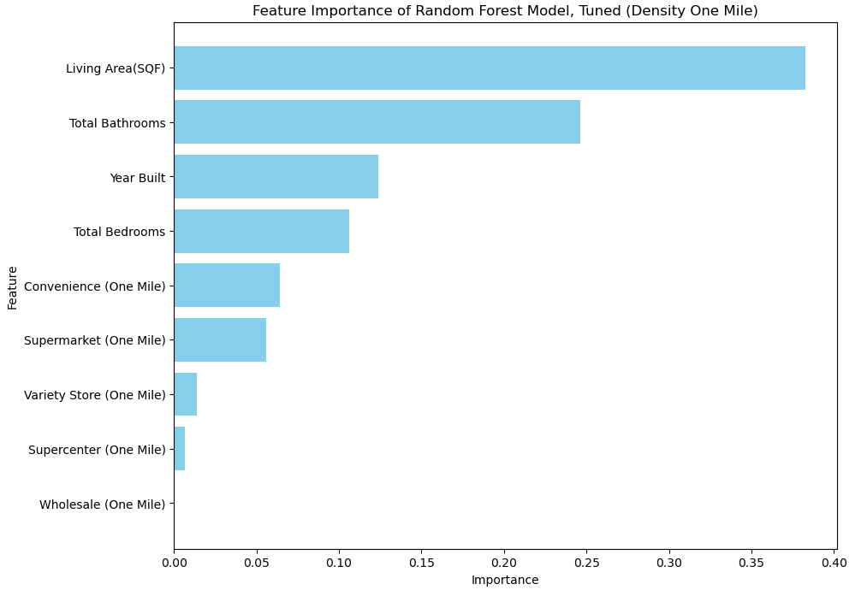
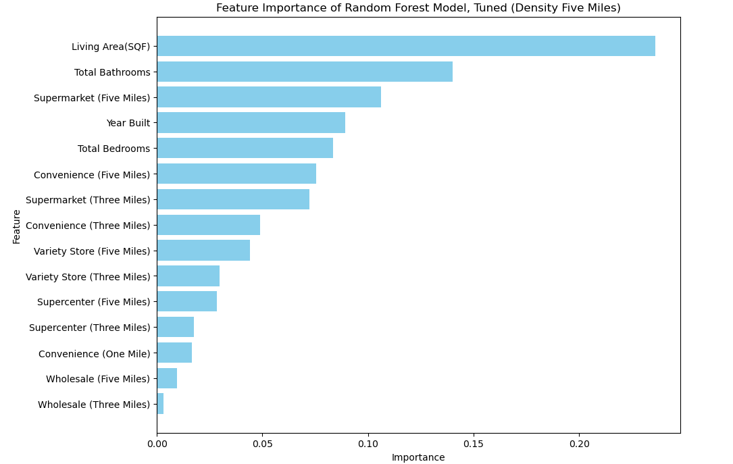
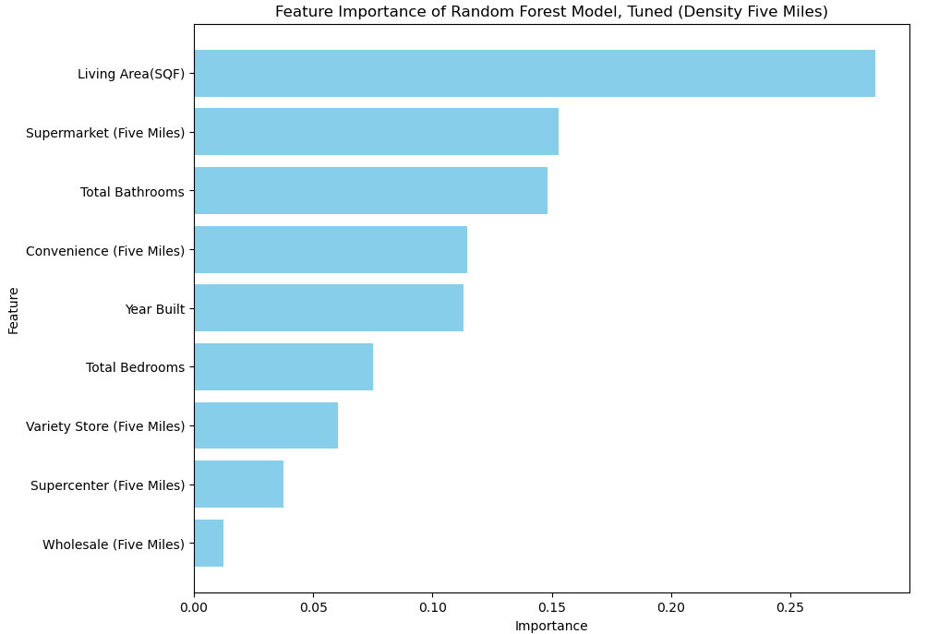
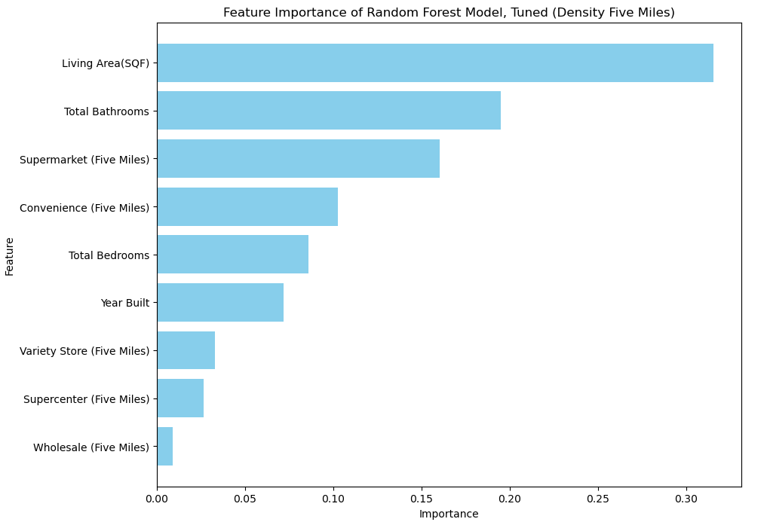
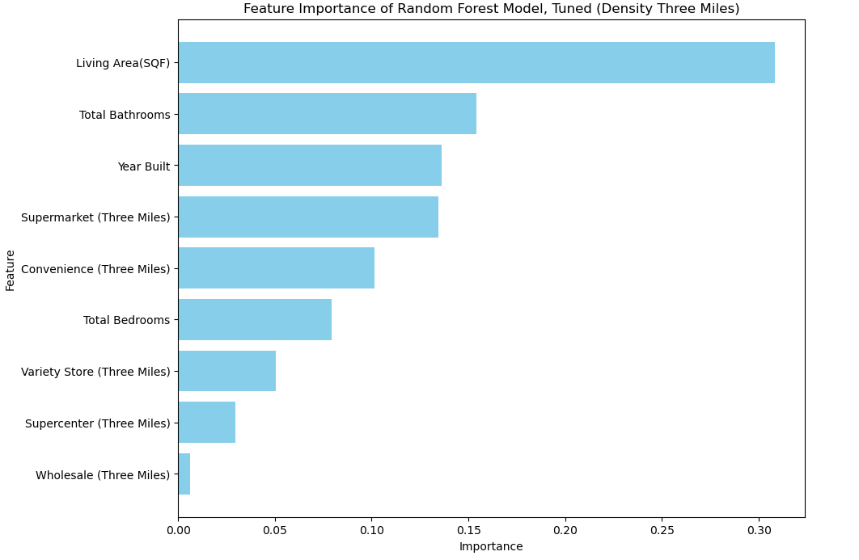
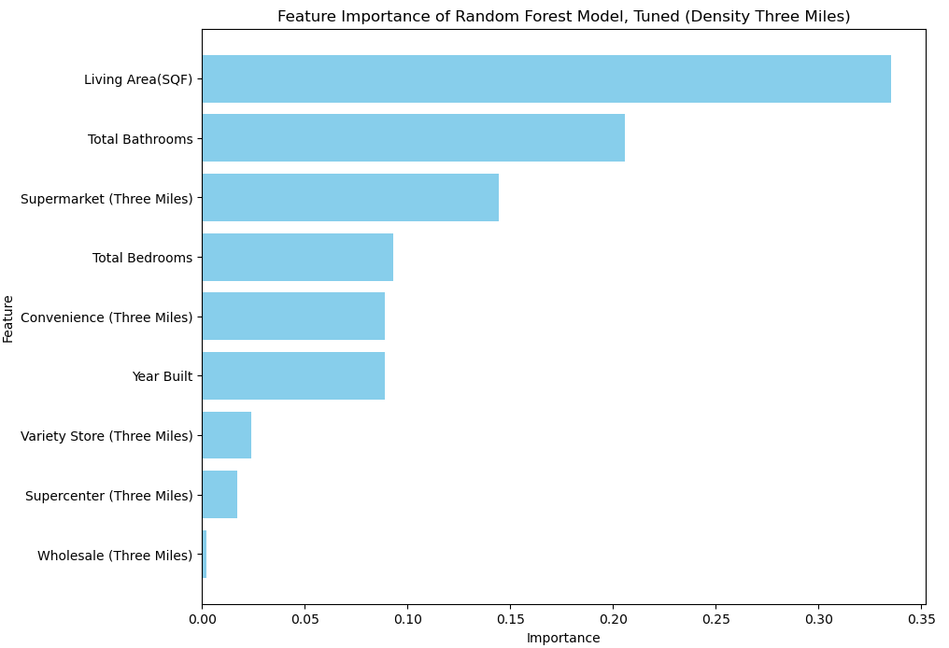
Random Forest: Density
Notes:
Supermarket and convenience stores vie for the top as the most influential factors. It seems as it approaches five, supermarkets will soon outpace even living area, as is consistent with the coefficients. Notably, Wholesale has almost no importance at one mile and then begins to gain some as the radius increases.

Slide 27
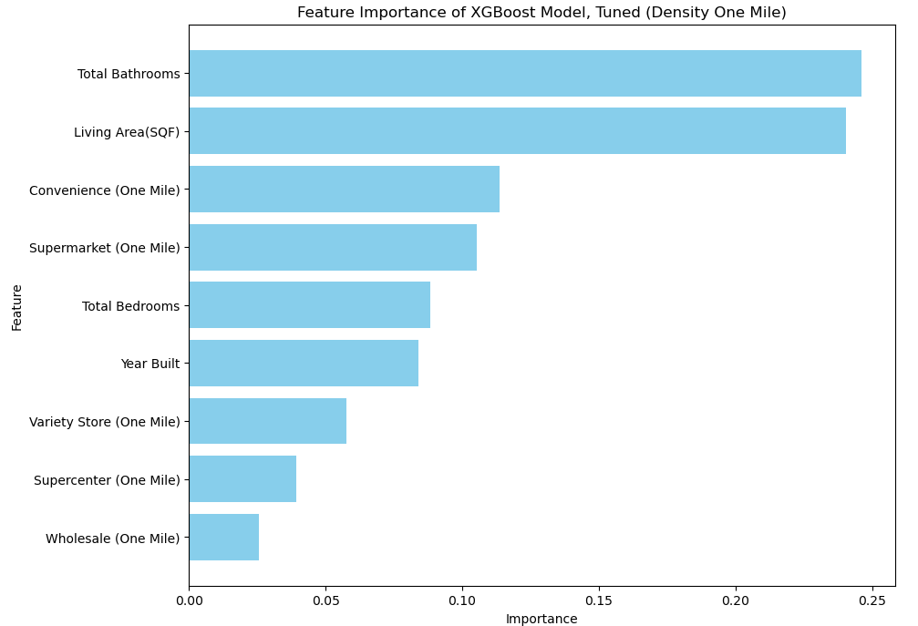
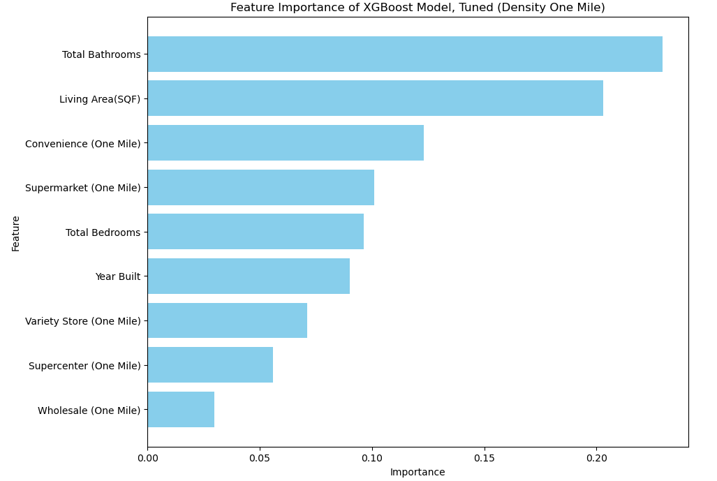
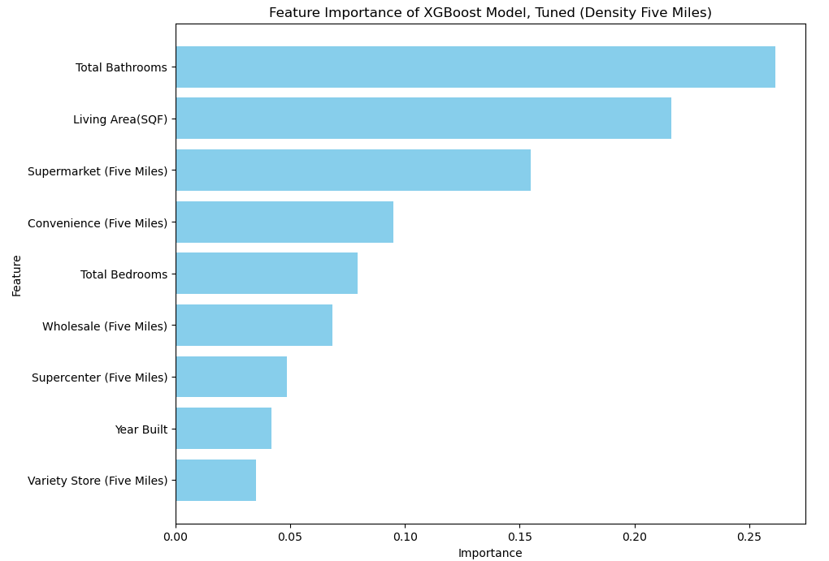
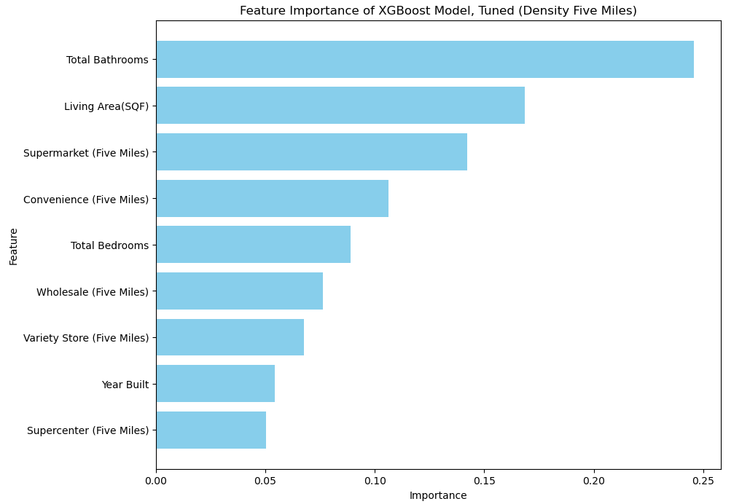
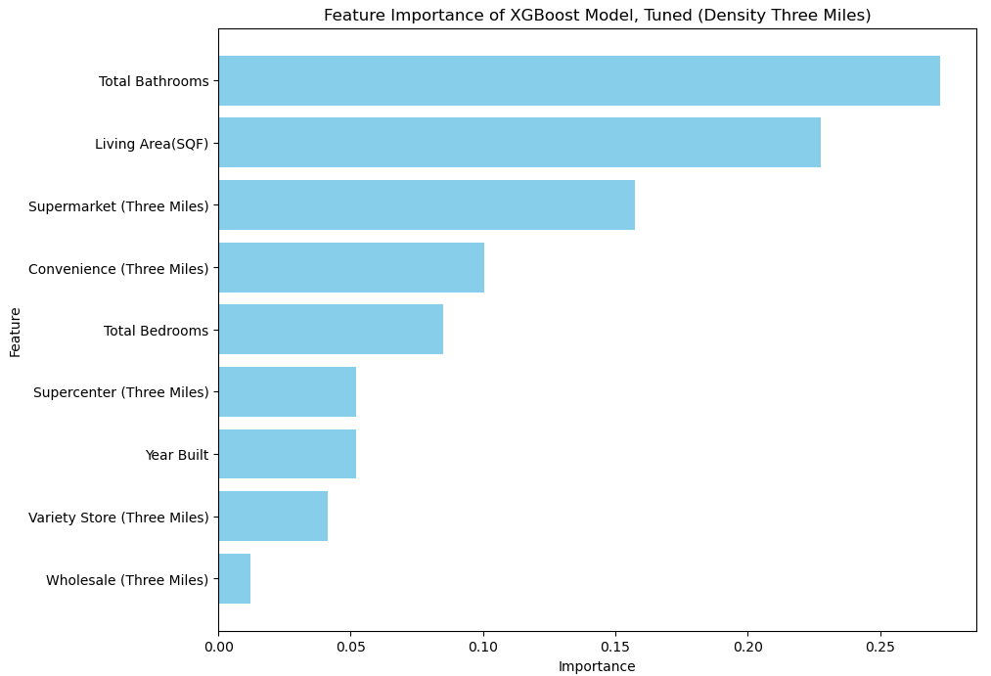
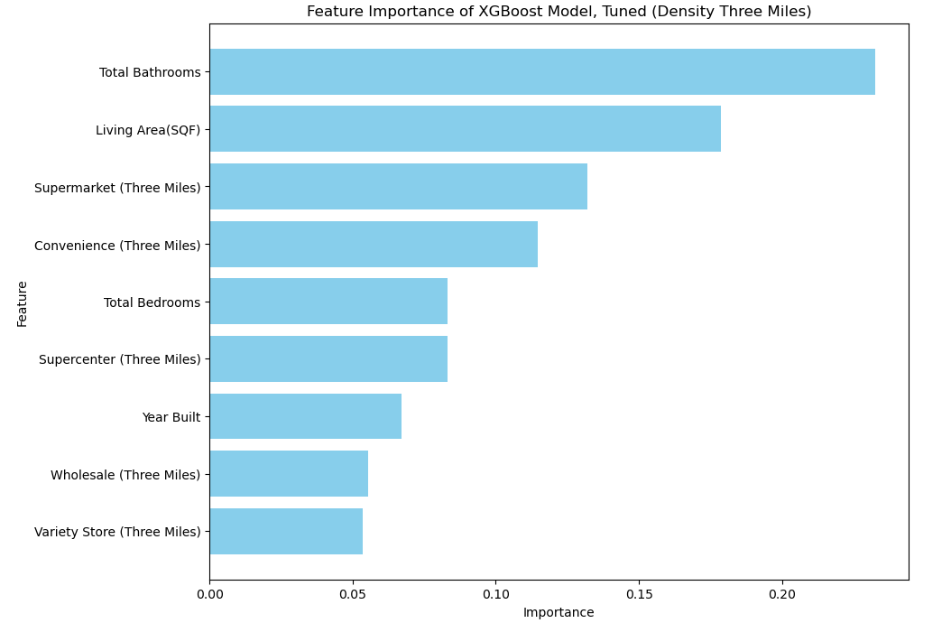
XGBoost: Density
Notes:
Unlike Random forest plot, the five miles implies a larger importance to wholesale, but overall a less max importance. Furthermore, Supermarket and Convenience are kept closer together in three miles.

Slide 28
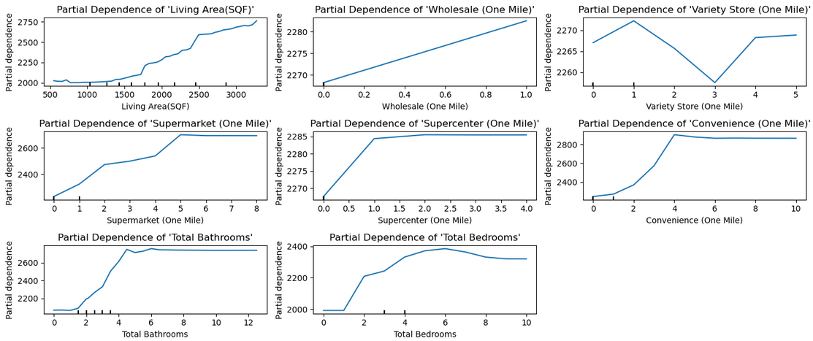
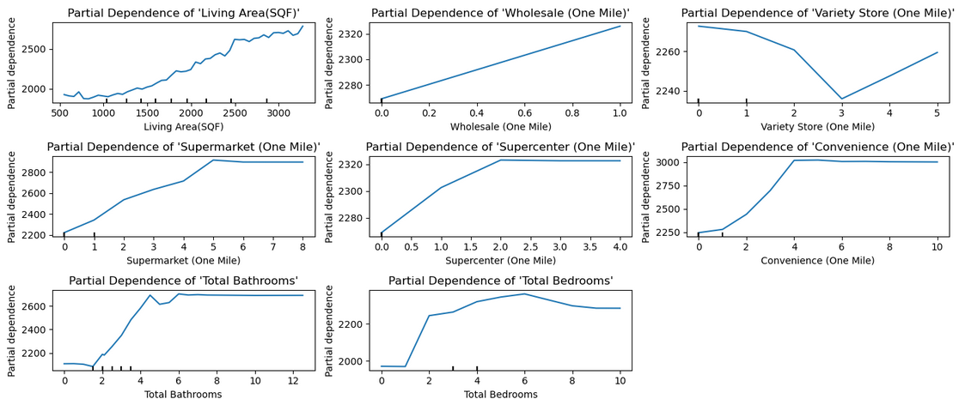
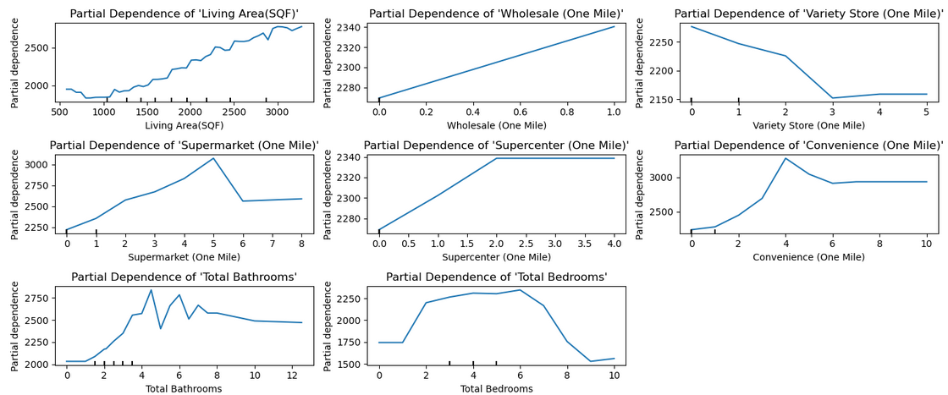
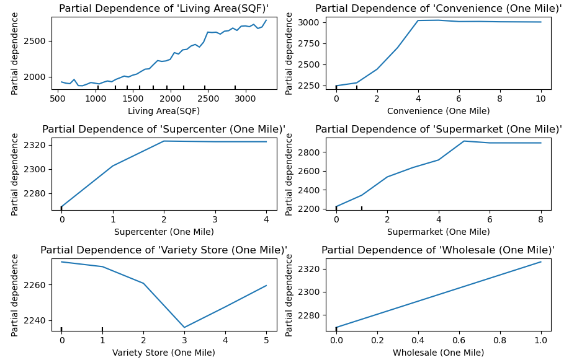
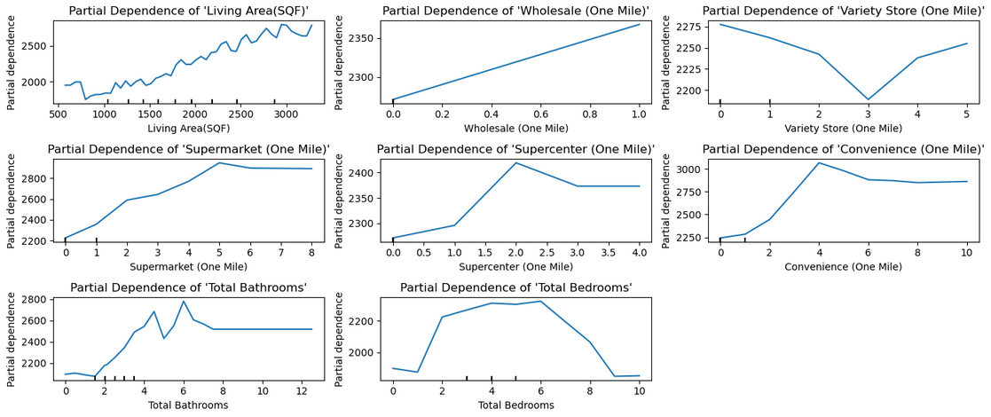
Random Forest: Density, Partial Dependency Display (One Mile)
XGBoost: Density, Partial Dependency Display (One Mile)
Notes:
One mile seems to imply, for almost all features, that, as the amount increases, the dependency increases with the exception of variety store. However, we know variety store previously had noise attached to it.

Slide 29
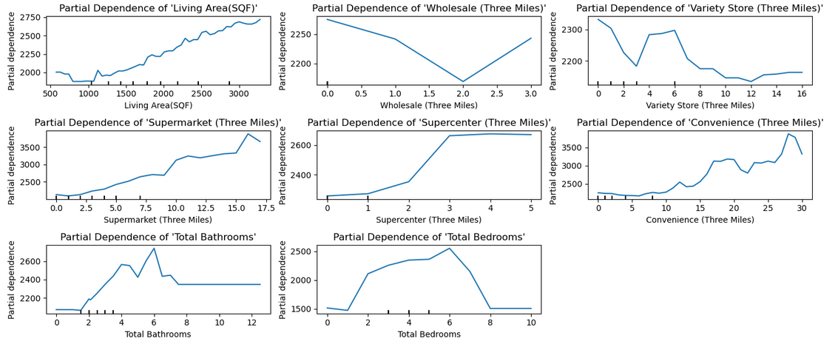
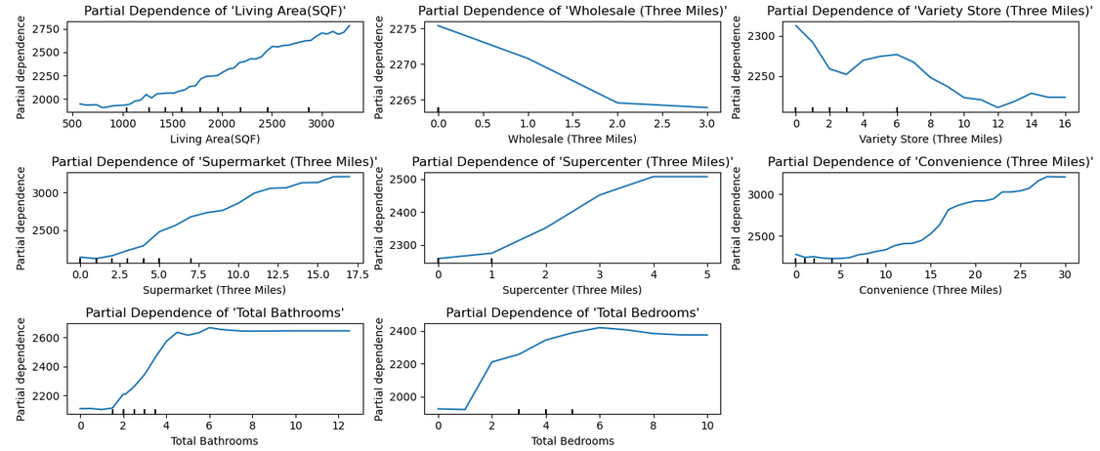
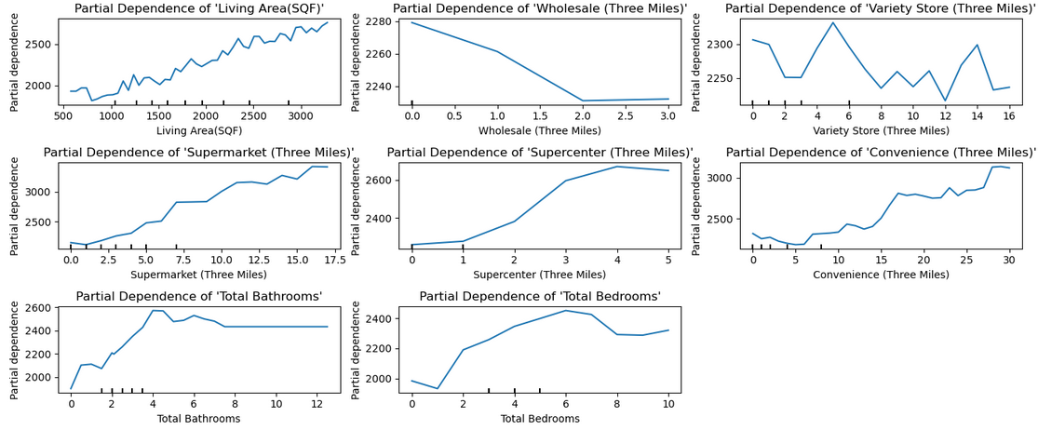
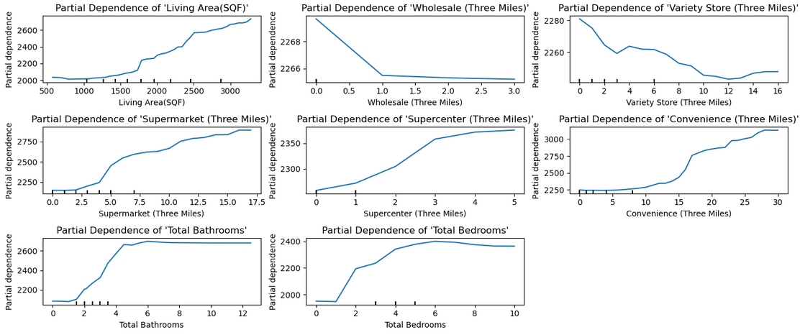
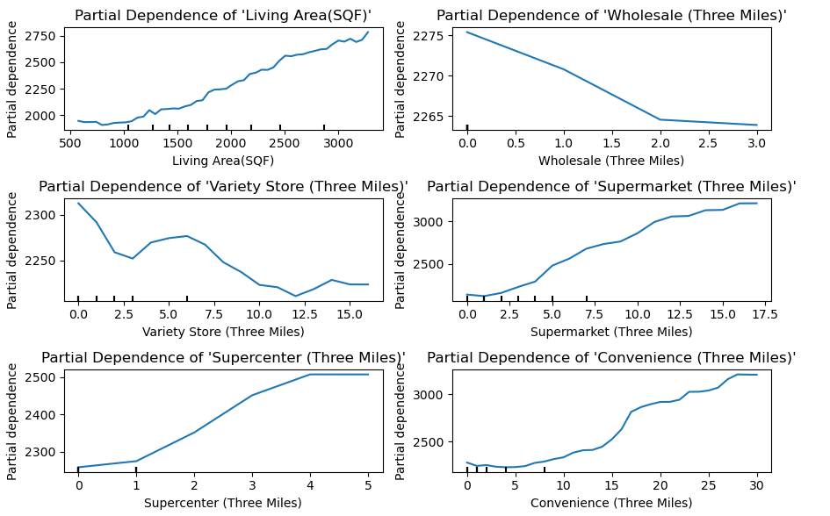
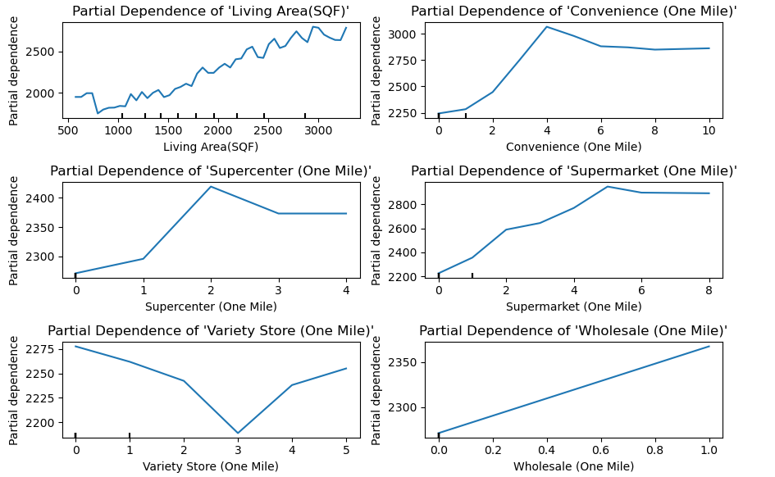
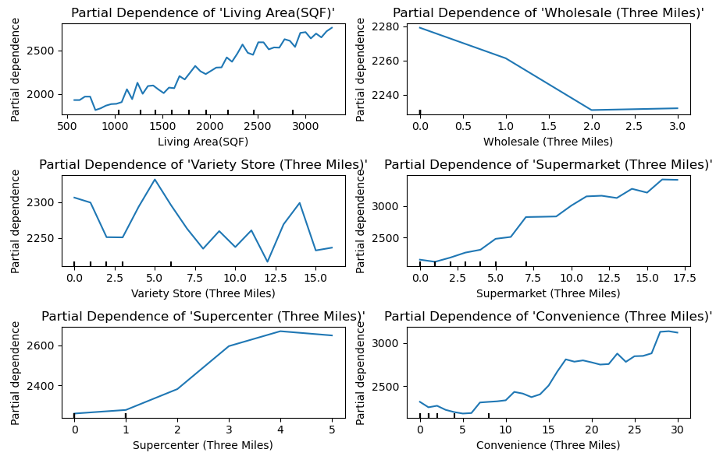
Random Forest: Density, Partial Dependency Display (Three Miles)
XGBoost: Density, Partial Dependency Display (Three Miles)
Notes:
Perhaps adding more clarity, it would seem that, as more stores increase around the house, the dependency increases, EXCEPT for variety store and wholesale. In addition, bathrooms and bedrooms seem to flatline for random forest.

Slide 30
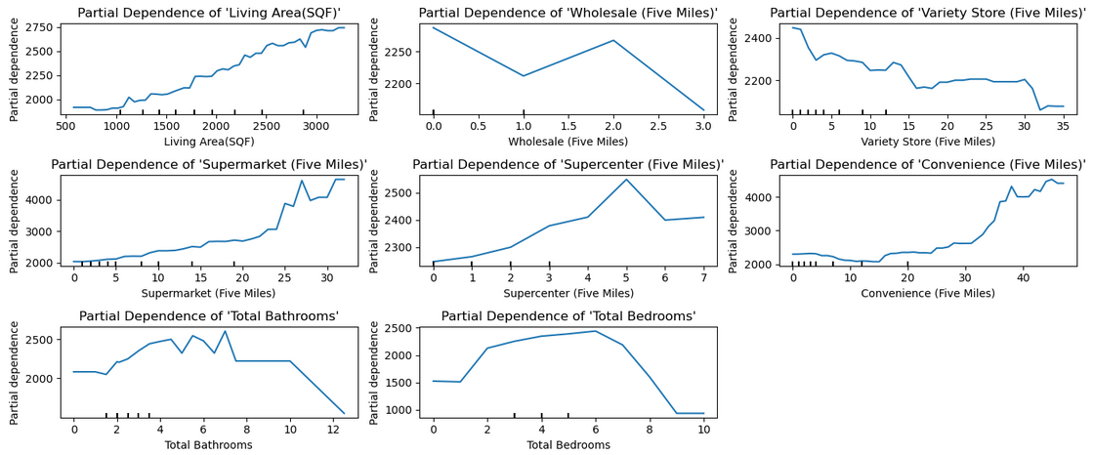
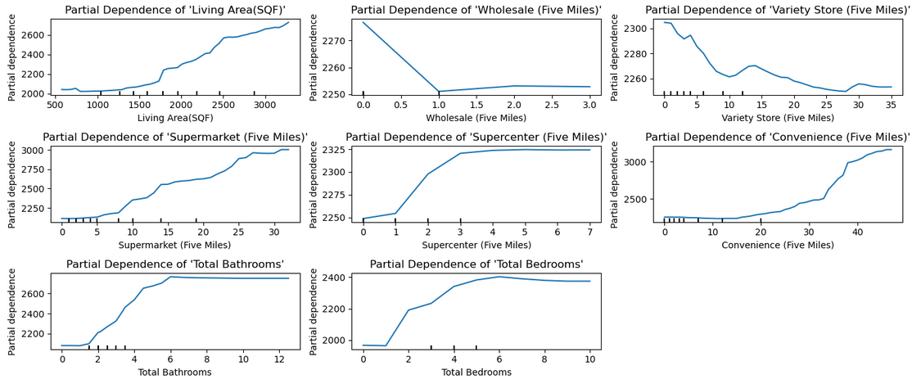



Random Forest: Density, Partial Dependency Display (Five Miles)
XGBoost: Density, Partial Dependency Display (Five Miles)
Notes:
Same applies here.

